Slide 1
Analysis of scRNA-seq data using bioconductor
Practices

Slide 2
Using Bioconductor to analyze scRNA-seq data
This section explains how to manipulate scRNA data with the help of bioconductor's native packages
Seurat is another popular R package that uses its own data object called Seurat. The Seurat package includes a very large collection of functions and excellent documentation. Due to its popularity, several other packages are now compatible with Seurat objects.
The Python package corresponding to seurat: Scanpy, which stores data in an object called AnnData (annotated data).
In this section, we will learn:
Importing the single cell data into R
Storage and use of different types of data (e.g., cellular, genetic information, etc.)
Filtering cells and genes
Presentation of the results
Notes:
Papalexi E and Satija R. Single-cell RNA sequencing to explore immune cell heterogeneity, Nature Reviews Immunology 2018 (https://doi.org/10.1038/ nri.2017.76)

Slide 3
1. Introduction
In bioconductor, single cell data is stored in SingleCellExperiment object
Create SingleCellExperiment object using scRNA-seq count data
Get the elements of the SingleCellExperiment object, such as rowData, colData and assay
Get information about the expression matrix
Subset of SingleCellExperiment object
Plotting the data of SingleCellExperiment object

Slide 4
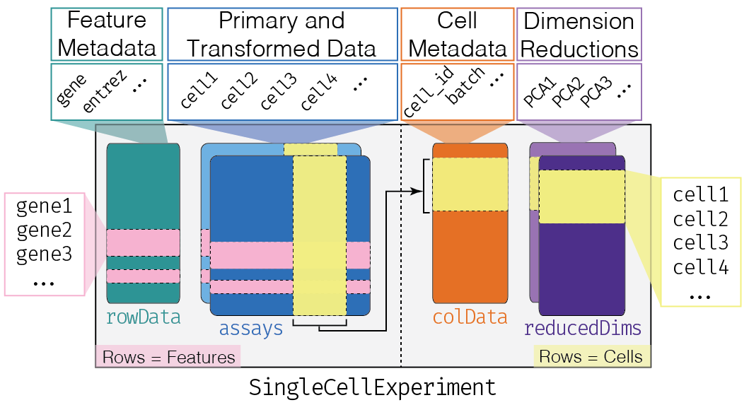
2. SingleCellExperiment object
SCE objects are used to store gene expression matrices, gene information (genomic location, type, etc.) and cell information (tissue origin, patient clinical characteristics, etc.)
In addition, SCE objects are capable of storing homogenized expression matrices, reduced dimensional expression matrices, etc.
Data access of SCE objects
The expression matrix can be accessed via the function ‘assay’ or ‘assays’
The gene information (the object row) can be obtained with the rowData function
The cell information (the object column) can be accessed with the colData function

Slide 5
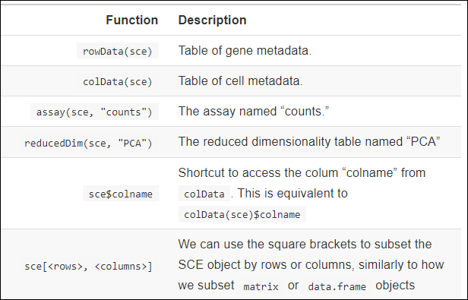
3. Tips
Tips for variable names
counts: raw read count data
normcounts: homogenized, same scale as original count
logcounts: logarithmically converted to the same scale as the original count
cpm: counts per million reads
tpm: transcripts per million
The data stored in the above variables have a corresponding method to access
The counts() function accesses the "counts" matrix.
Equivalent to assay(sce_obj, "count")
Notes:
Cpm This is the number of reads per gene in each cell, divided by the size of the library per cell (in millions).
This is the number of transcripts per gene in each cell, divided by the total number of transcripts in that cell (in millions).

Slide 6
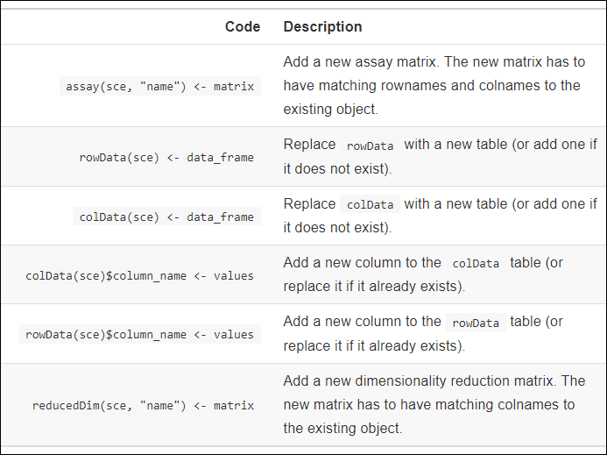
Summary of data manipulation methods of SCE objects

Slide 7
Useful references
OSCA: This book teaches users some common workflows for analyzing single cell RNA-seq data (scRNA-seq). It will show you how to process, analyze, visualize and explore scRNA-seq data using state-of-the-art Bioconductor tools. In addition, it is also an online companion book to the paper of the same name.
https://bioconductor.org/books/release/OSCA/index.html
Exercise data for 10X
https://www.ncbi.nlm.nih.gov/geo/query/acc.cgi?acc=GSE156625

